Slide 1

School Index (3rd Iteration) Recap
TAG Team
2024 Spring
Data Science
Senior Capstone Project
Client: StudyPool

Slide 2

Project Introduction
& Objective
Develop a comprehensive database of colleges, universities, and online schools in the United States tailored for student research needs.
Present data through a StudyPool website, offering centralized access to key information such as school location, website, logo, and picture, facilitating informed academic decisions.

Slide 3

Team Members/Roles
Niecia Say - Data Modeler & Team Manager
Cobi Miller - Data Analyzer & Client Liaison
Nathaniel Hemans - Visualizer & Project Documentation
Benardo Avancena - Client
Helen Merhout - Client

Slide 4

Team Plan
The plan for this iteration is as follows:
Continuing the process to automate the Extraction process of ETL
Working towards gathering the summary of the school after successfully capturing the logos of each of the schools
Porting data within the MySQL database
Cleaned dataset from the first and second iterations will be imported into MySQL with some operations applied to fit the format of MySQL.
Logos and descriptions to be implemented after cleaning of data files and finished web scraping.
Set back starting the process of setting up the back of the website to communicate with the database
Research about the process of website to database connection
Understand what PHP does and how it would work with the website

Slide 5

Dataset
Title: Comprehensive Dataset of U.S. Colleges and Universities
Description: Provides extensive information on post-secondary educational institutions across all 50 states and U.S. territories. It includes details such as location, identifiers, contact information, population, industry codes, source references, website URLs, educational programs, enrollment statistics, housing facilities, employment data, and shelter identification.
Progress:
Cleaned dataset
Removed unnecessary columns
Filtered dataset to include 100 colleges from Georgia
Challenges faced: Difficulty finding logos and mission statements for schools
Resolution: Implementing web scraping to gather school logos
Technologies Used: Google Colab, Serpapi, Python, Excel

Slide 6
Statistical Developments
Tableau visualization created.
Demonstrations (initial and current visualizations).

Slide 7
Database Implementation
MySQL database created.
Added primary key and not unique constraints.
Working with technical team at Studypool on connecting the website and database.

Slide 8
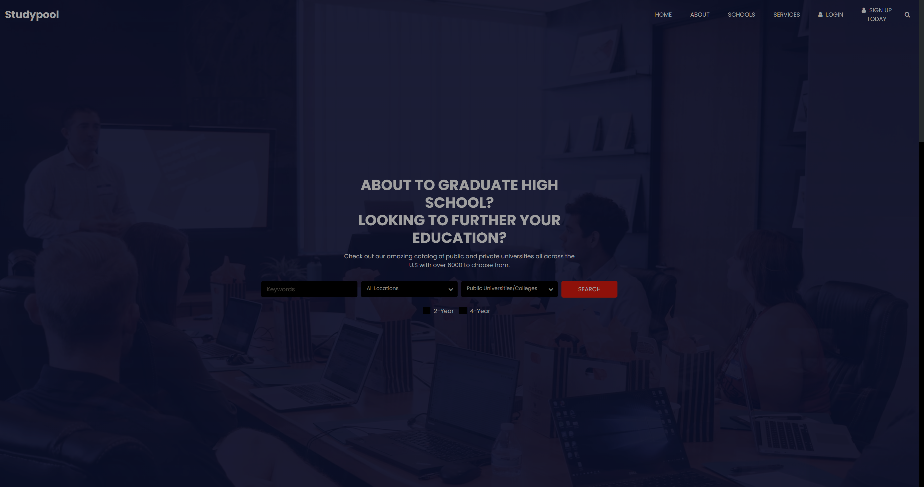
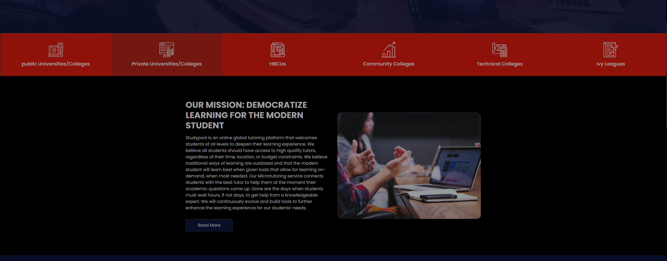
Website Prototype
Website Template Link :
Website Template Site
Website was based on a template that provides the respective HTML & CSS files for editing the site.
Goal for this iteration was to have a website that was functional in theory with proper HTML code unlike the first mock website.
Elements of the website was edited to be more in line to the functional requirements listed by the clients

Slide 9
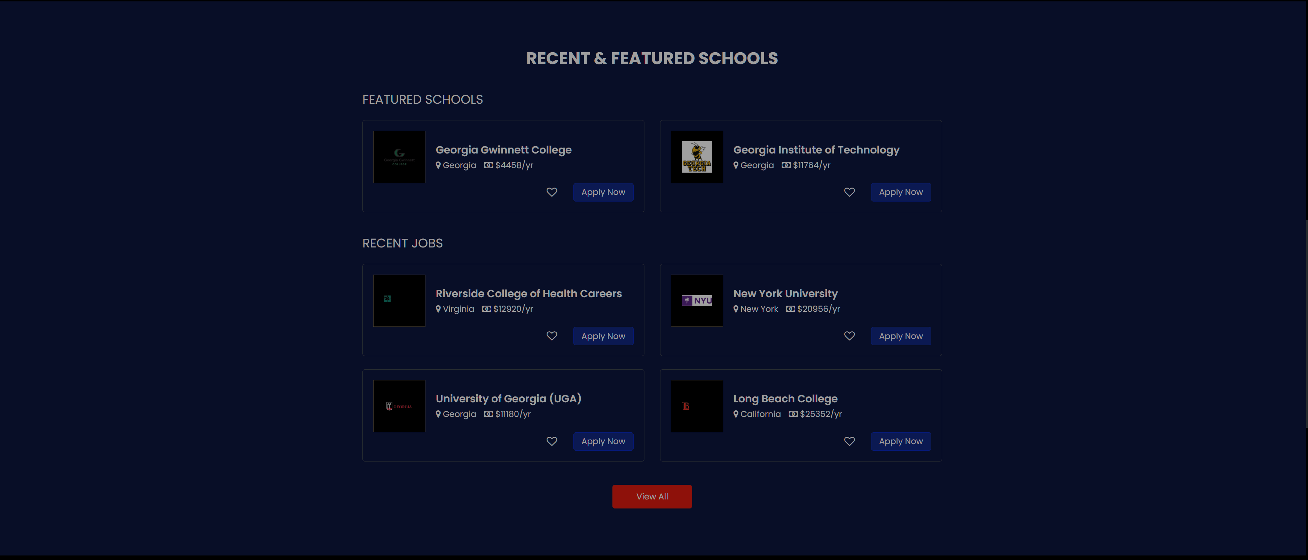

Website is majority of the way done, there are some elements that I haven't decided whether or not it would be kept in or completely removed for the time being.
I plan on (if there is time available) redesigning the website to fit the the color palette of the clients' brand
Once the database becomes fully functional, plans will be made to then connect the website to the database via the client's API

Slide 10
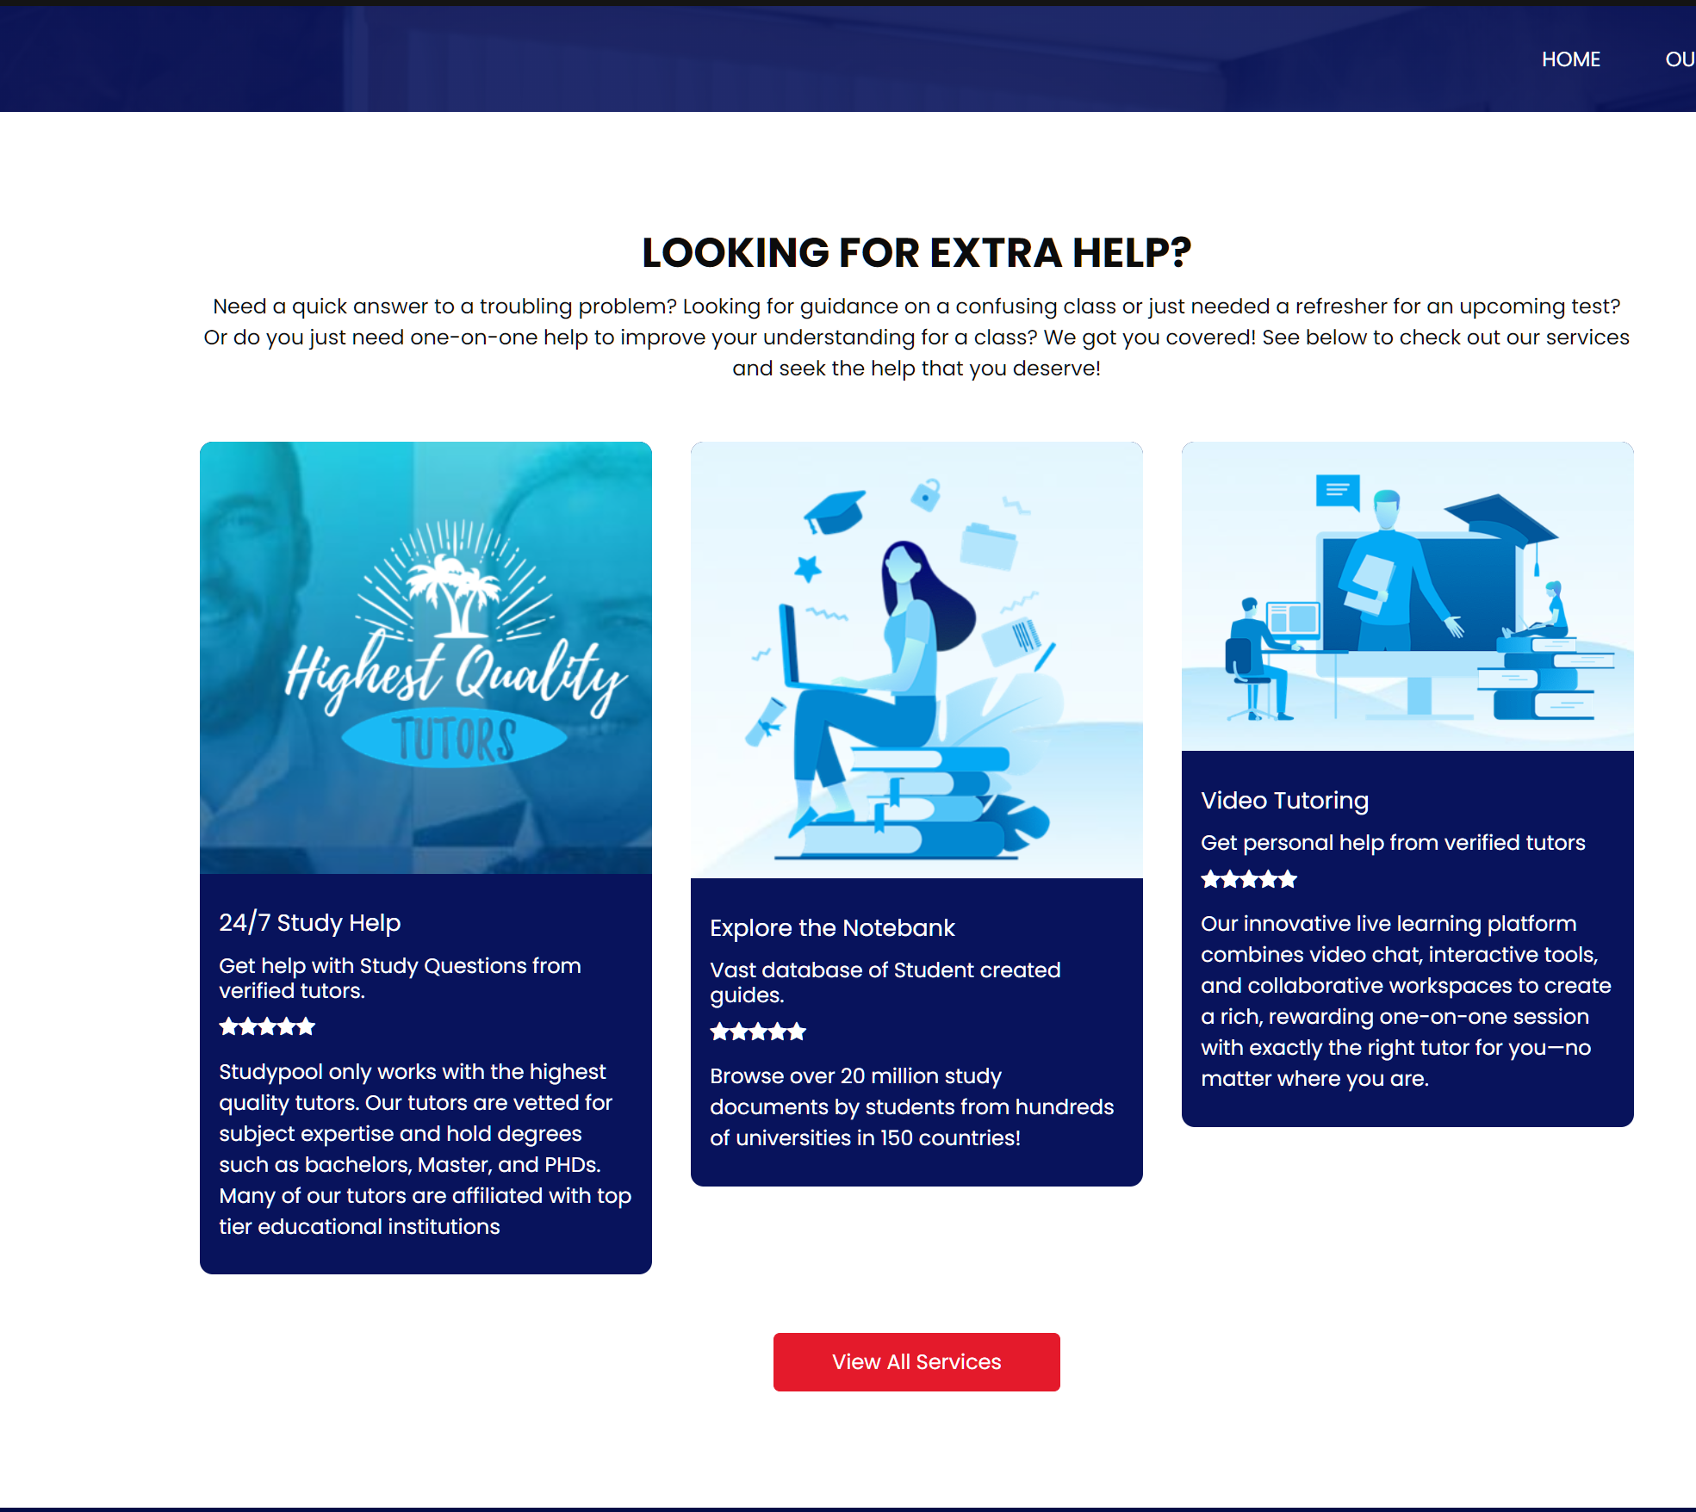
Client Services Page

Slide 11

Status Update

Slide 12

Achievements
Finished data visualization
Database created and ready to be connected to Studypool's APIs.
Progress on logos data file cleaning
Added Client’s extra services to the website which are reviewable
Linked other parts of the website together through the top header

Slide 13

Tasks Remaining
Finish cleaning the logos data file
Fully connect the MySQL database to the website

Slide 14

Client Communication
Client meeting held 28th of March
Feeback on the data extraction process, data analysis results, and website design and creation
New insights on what to look for regarding school mission statements
Client had no preference for or against having some level of data analysis on the website
Client would like website to match with branding and style of company though not of high priority and would like the back end to be established first
Next client meeting will be scheduled at a later point.
Already establishing communications for database and website connection.
Final changes and implementations to the website.

Slide 15

Performance Overview
1st iteration: getting started
Gathering client requirements, setting up technologies
Finding databases, initial data cleaning
Statistical outline
Website mockup
2nd iteration: finding our footing
Web crawling for logos
Experimenting and implementing data analysis/statistics
Creating website functionality

Slide 16
Performance Overview
3rd iteration: steady progress
Web crawling for descriptions
Finishing data analysis, improving visualizations
Adding website functionality, preparing for database integration
Future: finishing touches
Cleaning logos and descriptions CSV files from web crawling for use on website
Work with technical team at Studypool to connect the database and website
Implement all possible website functionality.

Slide 17
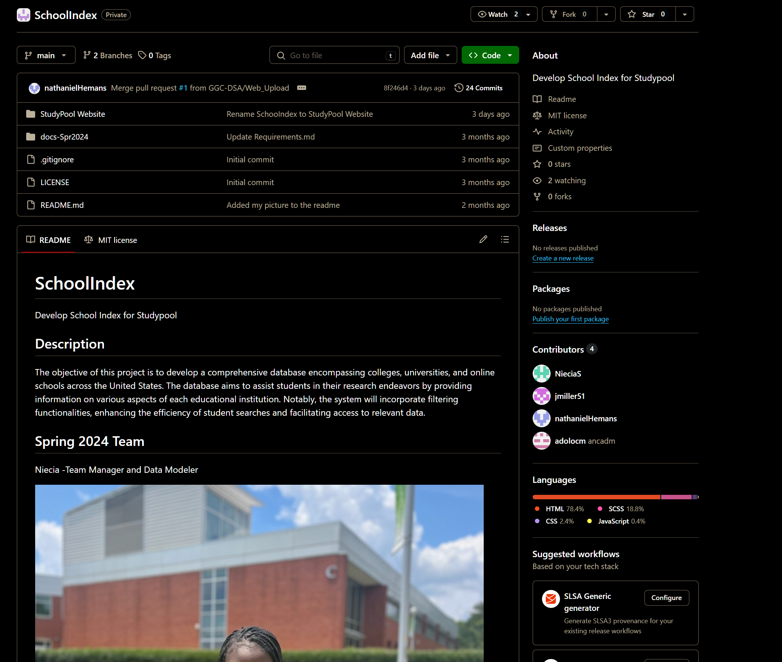
GitHub Repository

Slide 18

Links
GitHub
Jira
Notebook

Slide 19

Questions

